Slide 2
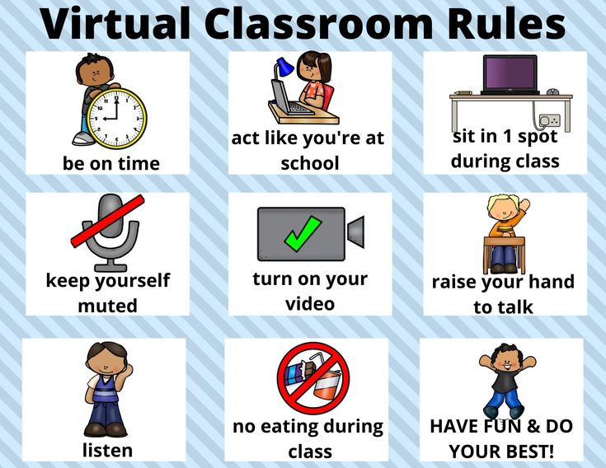

Slide 3
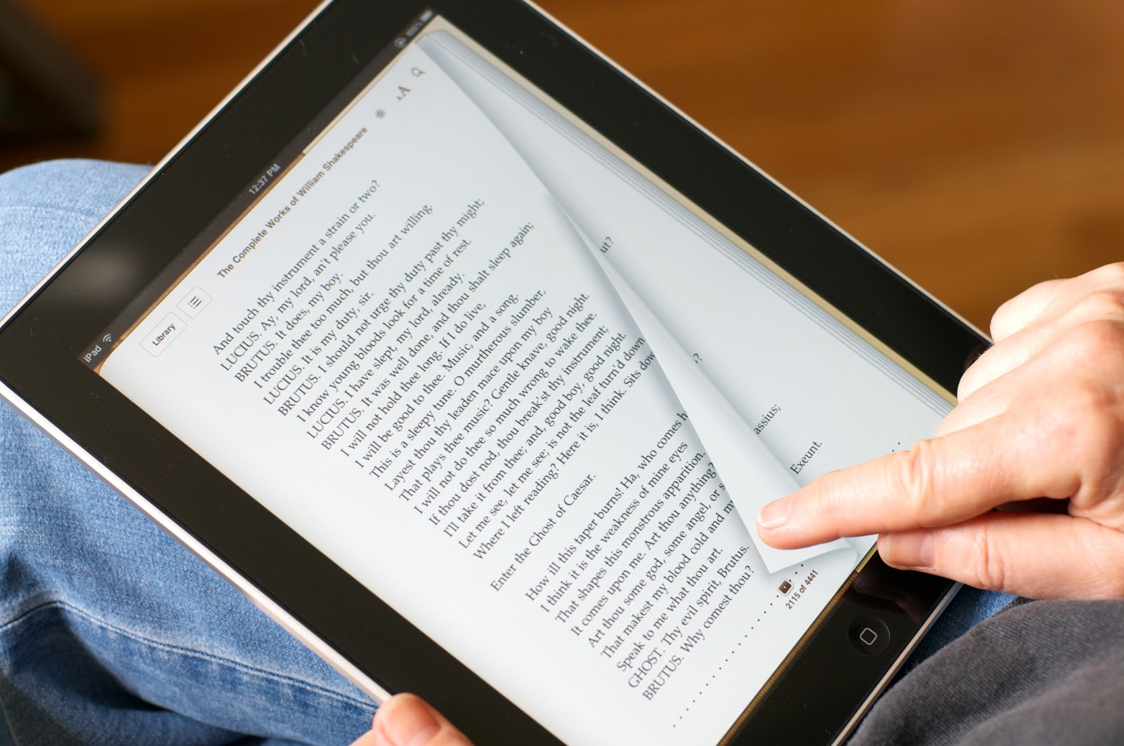
I like reading.
She likes reading.

Slide 4
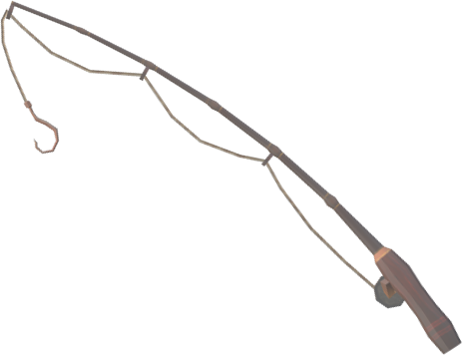
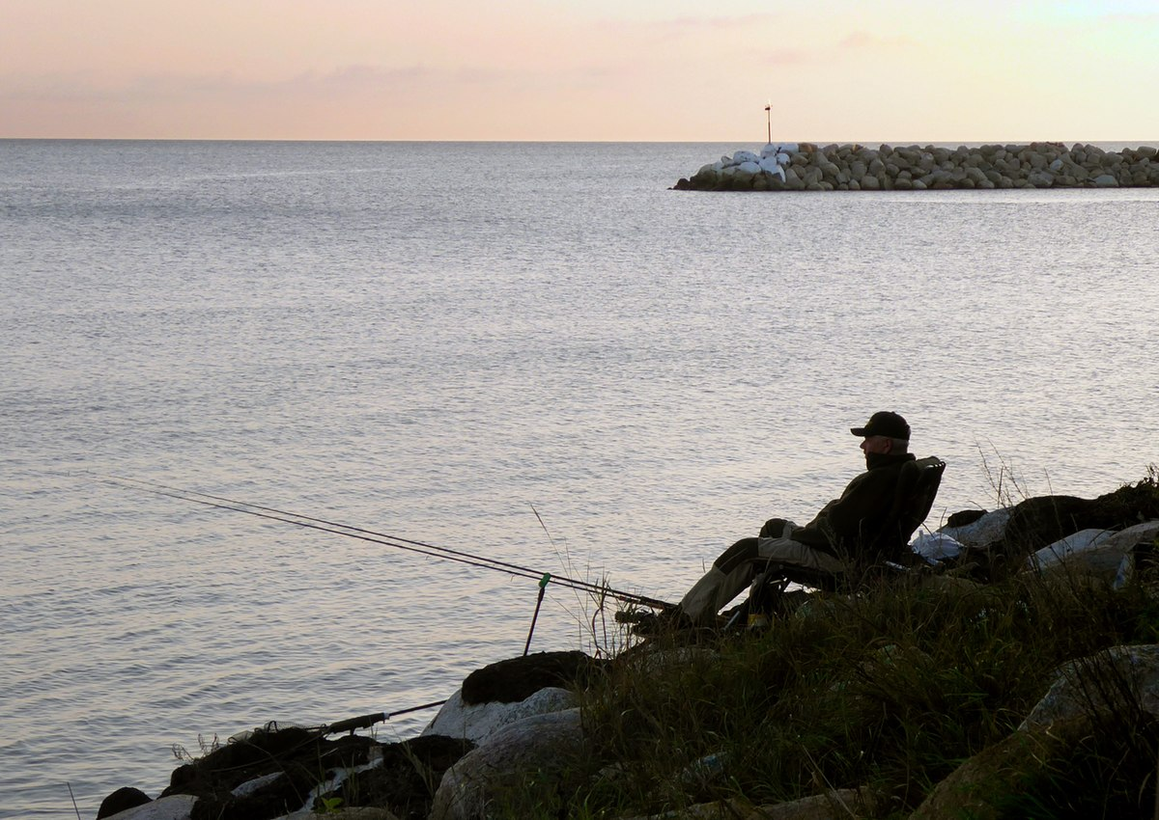
I don’t like fishing.
He doesn’t like fishing.

Slide 5
Let’s play a game.

Slide 6
LIKES
DOESN’T LIKE
LIKE
DON’T LIKE

Slide 7
LIKES
DOESN’T LIKE
I
He
You
SHE
She
We
It
IT
They
LIKE
DON’T LIKE

Slide 8
He
I
You
She
They
We
It
LIKE
DON’T LIKE
LIKES
DOESN’T LIKE

Slide 9
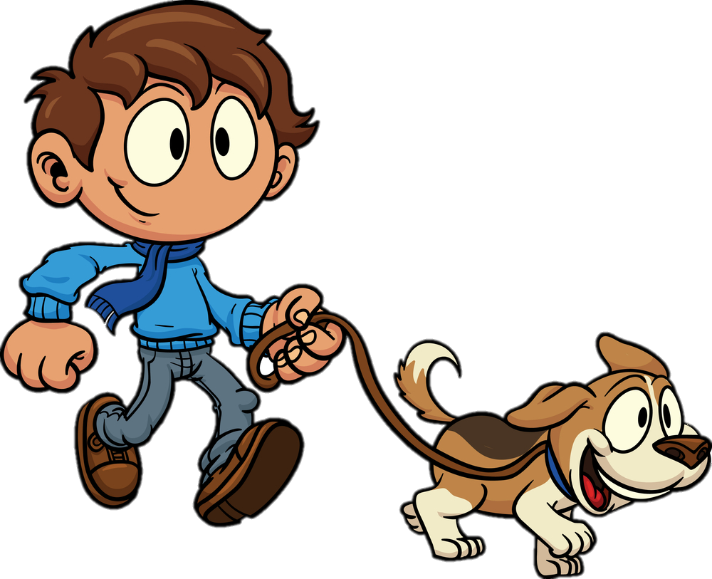
I like walking a dog.
I

Slide 10
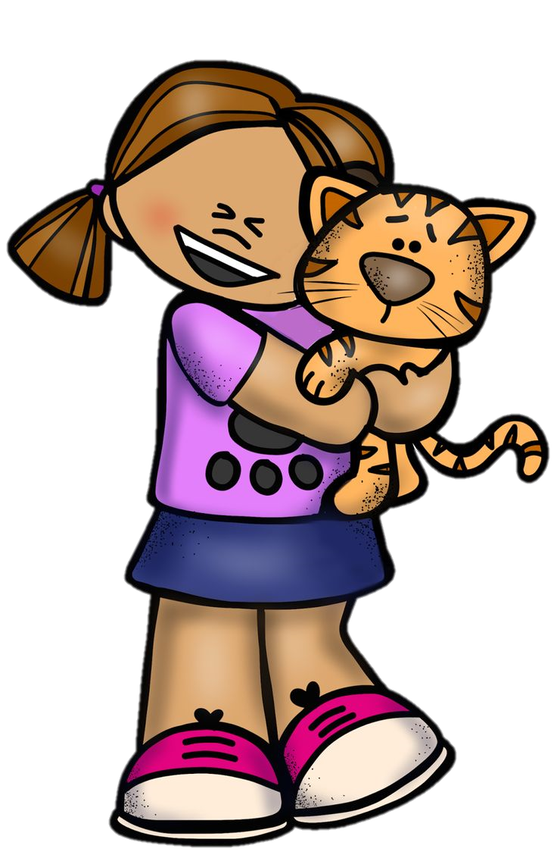
She likes playing with a cat.
Kate
She

Slide 11
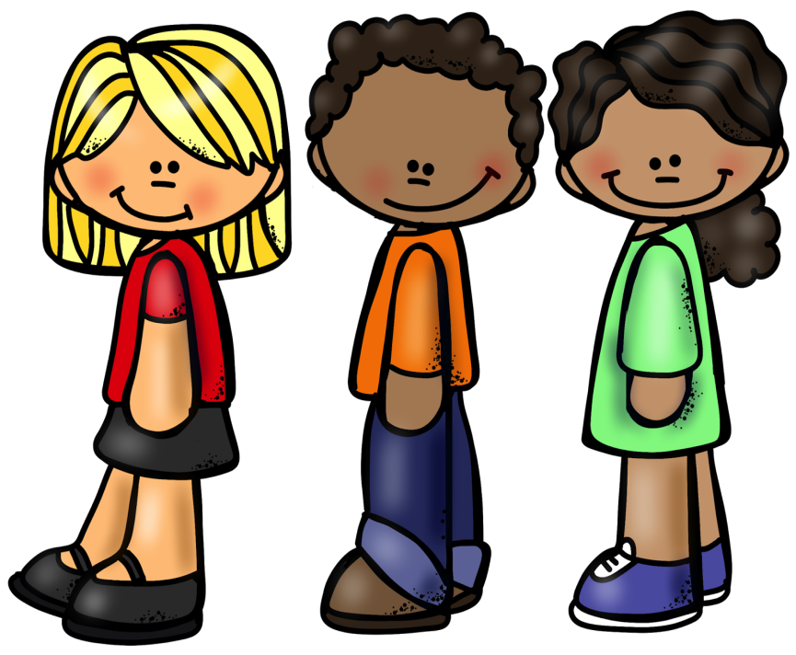
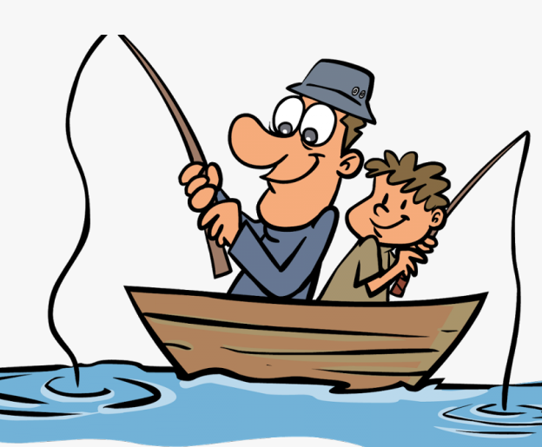
We don’t like fishing.
We
Kate

Slide 12
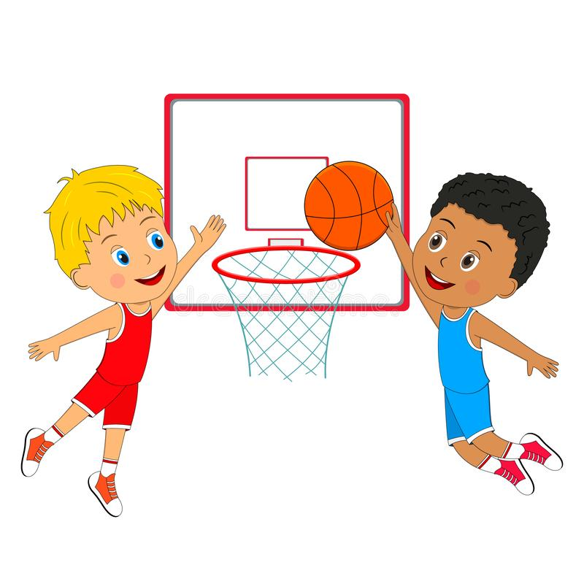
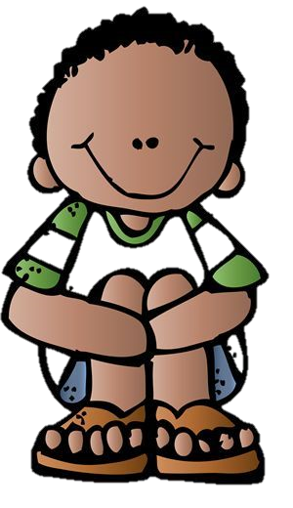
He doesn’t like playing basketball.
He
Kate

Slide 13
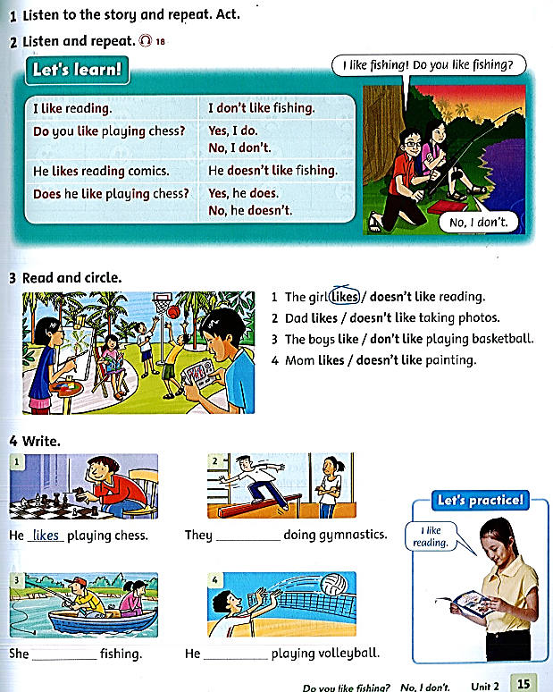
Student book page 15.

Slide 15
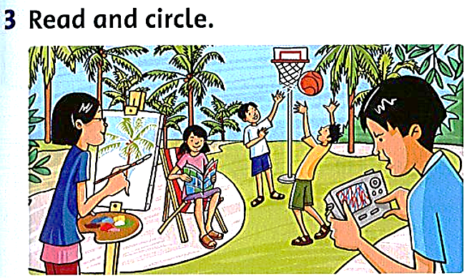

Slide 16
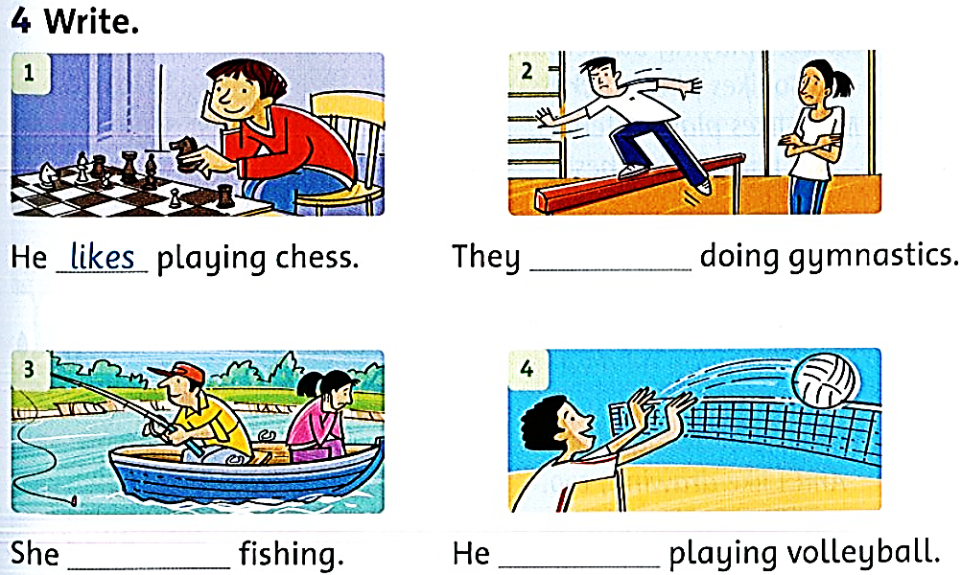
don’t like
doesn’t like
likes

Slide 17
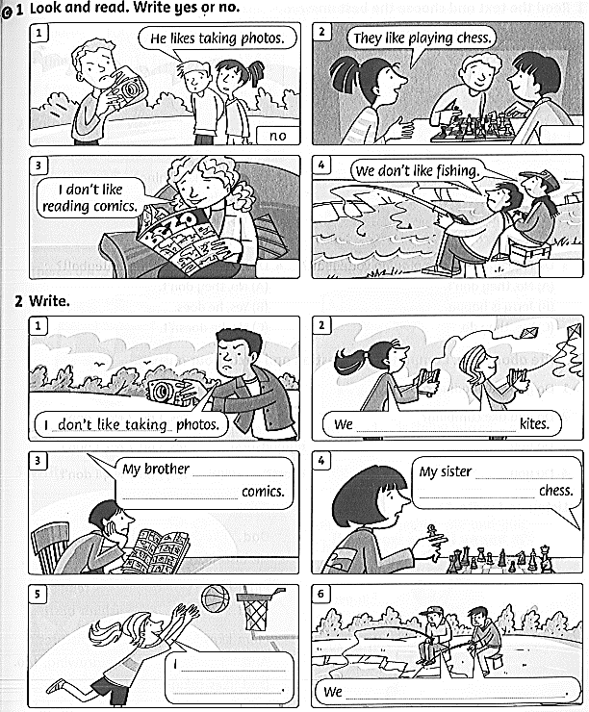
Workbook page 15

Slide 18
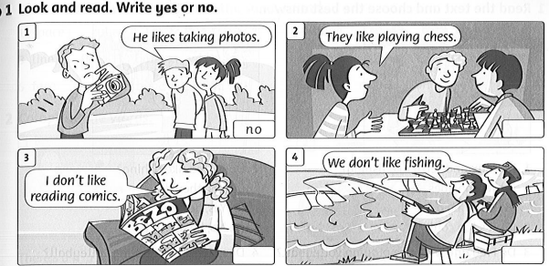
yes
no
yes

Slide 19
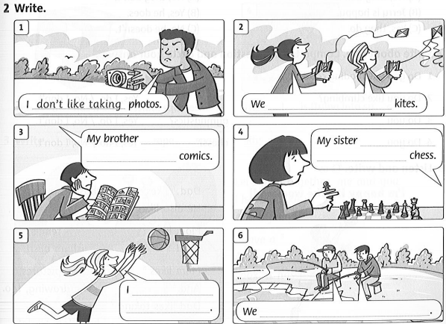
like flying
doesn’t like
doesn’t like
reading
playing
like playing
basketball
don’t like fishing

Slide 20
Homework
Do exercise on Liveworksheet
https://www.liveworksheets.com/ep1188984ab

Slide 21
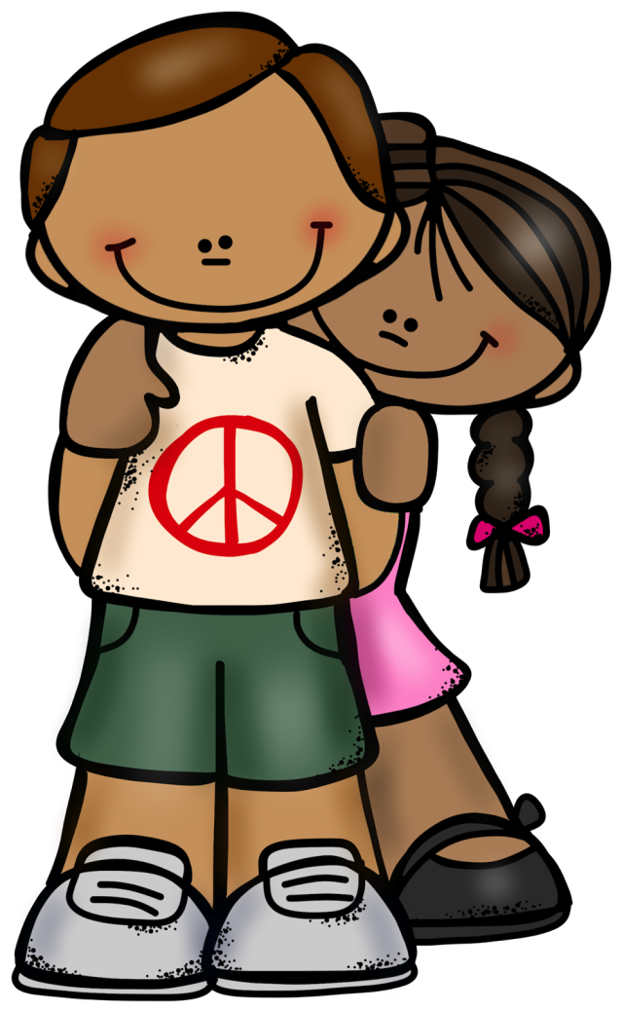
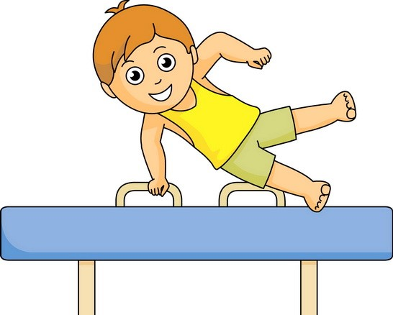
Tim and Liz don’t like doing gymnastics.
Tim and Liz

Slide 22
Kate doesn’t like reading comics.
Kate

